Slide 1
Characteristics and use of the Illumina BovineLD BeadChip (abstr. 450)
Courtesy of Illumina, Inc.

Slide 2
Low-density array background
Illumina BovineLD BeadChip (6,909 SNP) replaced Bovine3K BeadChip
BovineLD chip includes add-on capability to allow array customization up to 80,000 SNP
GeneSeek Genomic Profiler (GGP) with 8,654 SNP and single-gene tests developed from BovineLD chip

Slide 3
Low-density array design goals
Higher SNP density at chromosome ends to aid imputation
High minor allele frequency
Adequate overlap with Bovine3K chip
Focus on dairy, but useful for beef
Use Infinium chemistry for improved reliability

Slide 4
Additional SNP on GGP
Single-gene tests
Increased overlap with Bovine3K chip
Imputation of microsatellite alleles
Elimination of large gaps between SNP

Slide 5
Distribution of SNP by chromosome
SNP group | BovineLD |  | GGP
Autosome | 6,651 |  | 8,291
X pseudoautosomal region | 17 |  | 17
X-specific | 219 |  | 268
Y | 9 |  | 19
Mitochondrial | 13 |  | 13
New | — |  | 46
Duplicates | — |  | 108
All SNP | 6,909 |  | 8,762

Slide 6
SNP overlap with other Illumina arrays
BeadChip | BovineLD |  | GGP
BovineSNP50 v2 | 6,854 |  | 8,029
Bovine3K | 2,159 |  | 2,677
BovineHD unique | 17 |  | 486
All Illumina arrays | 6,909 |  | 8,608
Used in genetic evaluation | 6,836 |  | 8,031

Slide 7
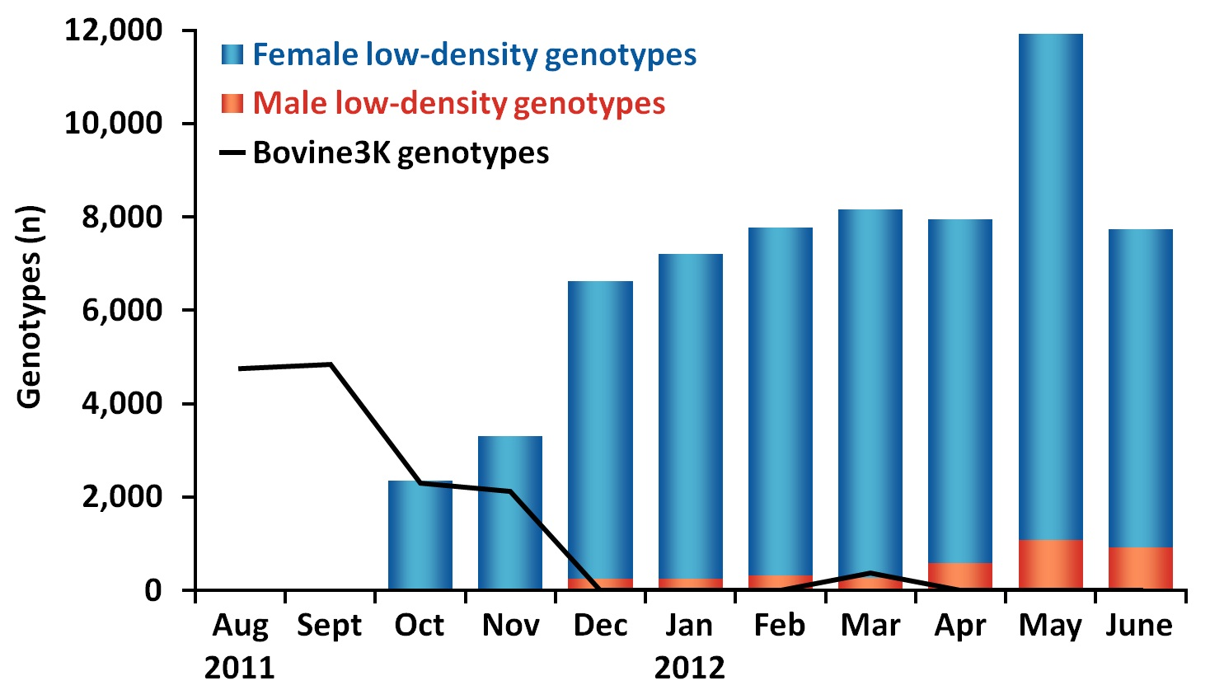
Low-density genotypes received

Slide 8
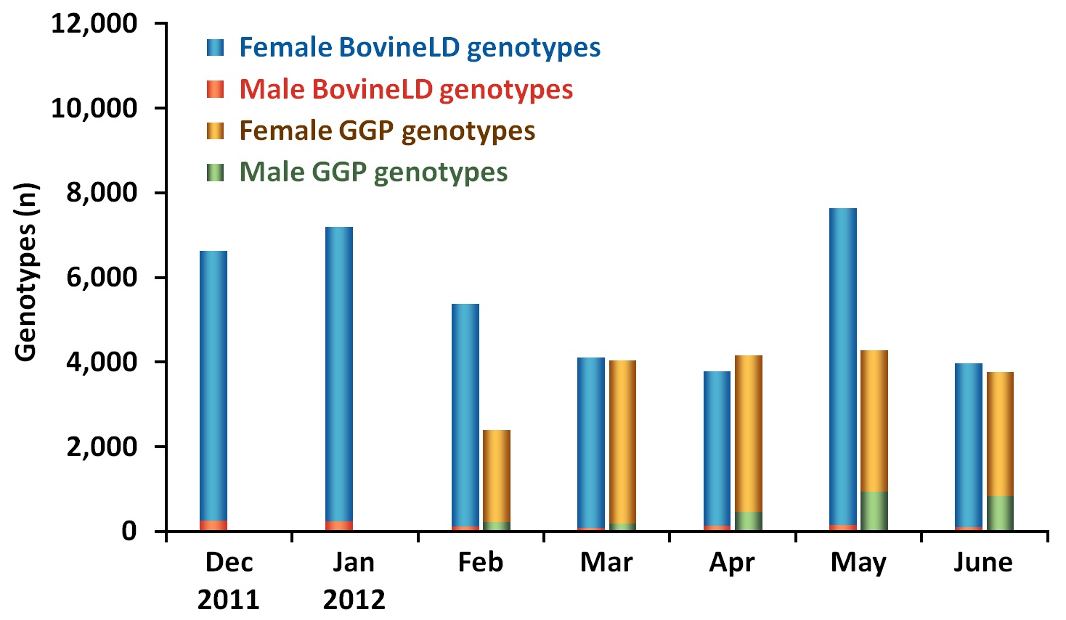
Breakdown by genotyping chip

Slide 9
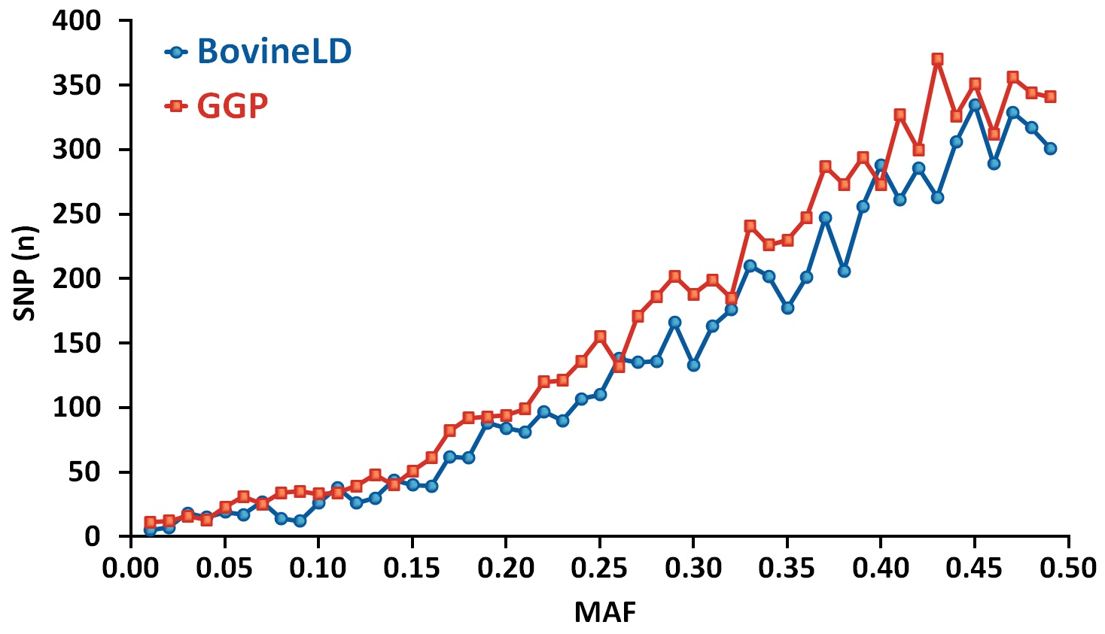
Minor allele frequencies (MAF)

Slide 10
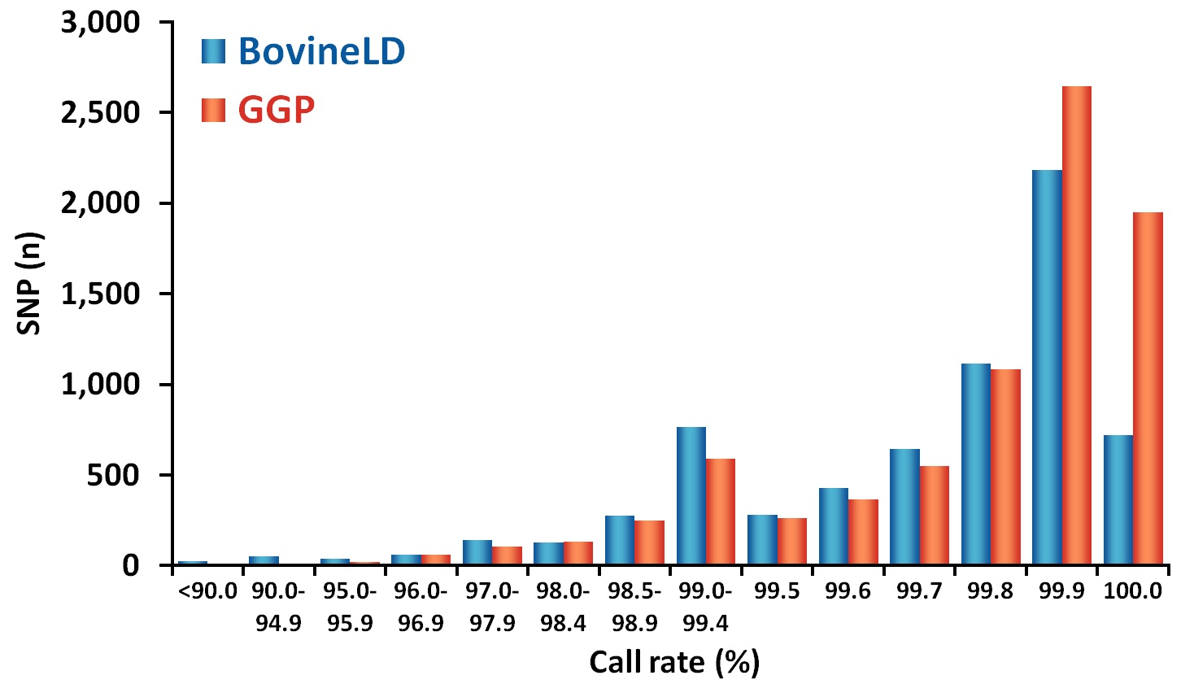
SNP call rates

Slide 11
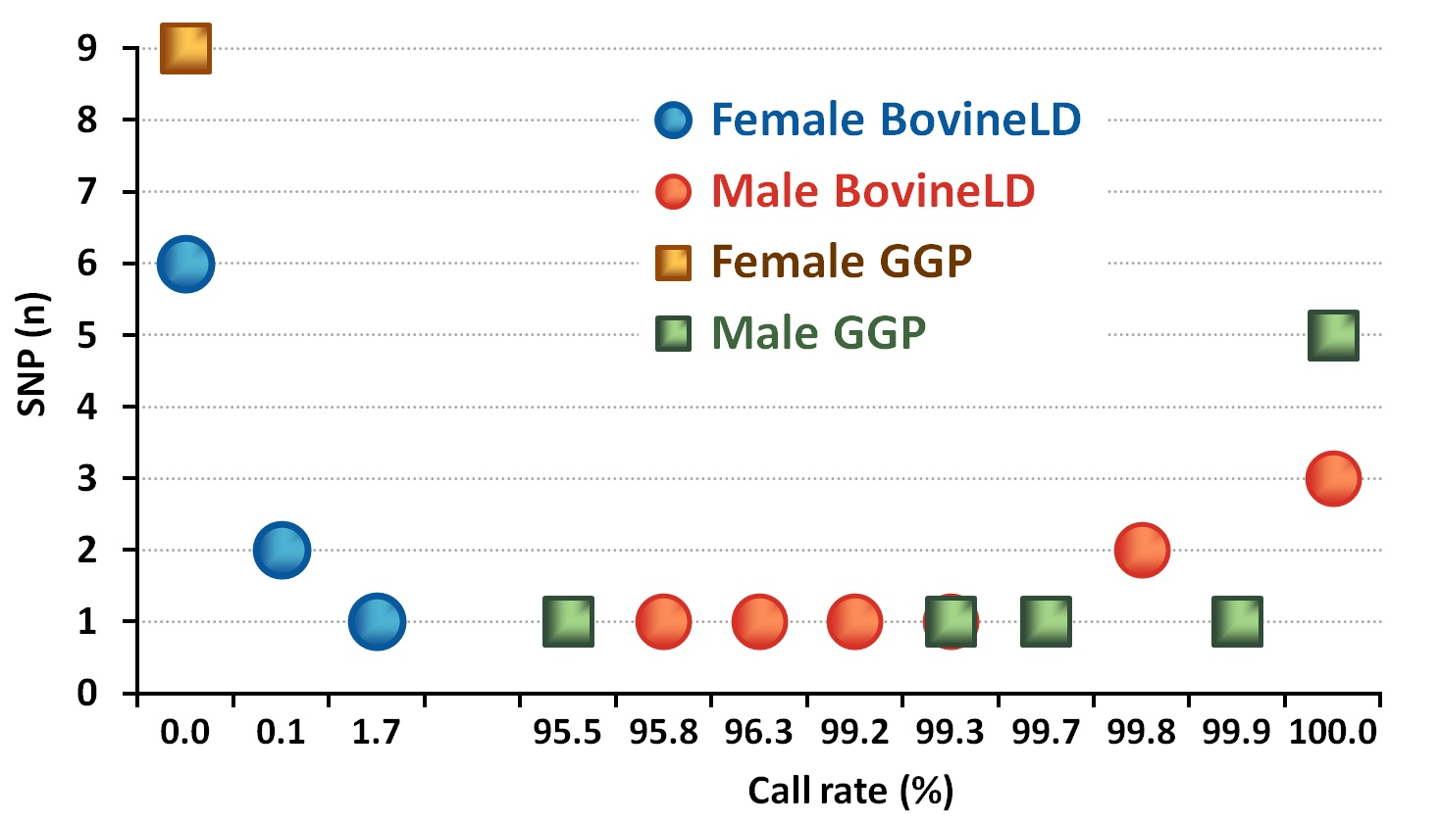
Call rates for Y SNP in common
–
/ /

Slide 12
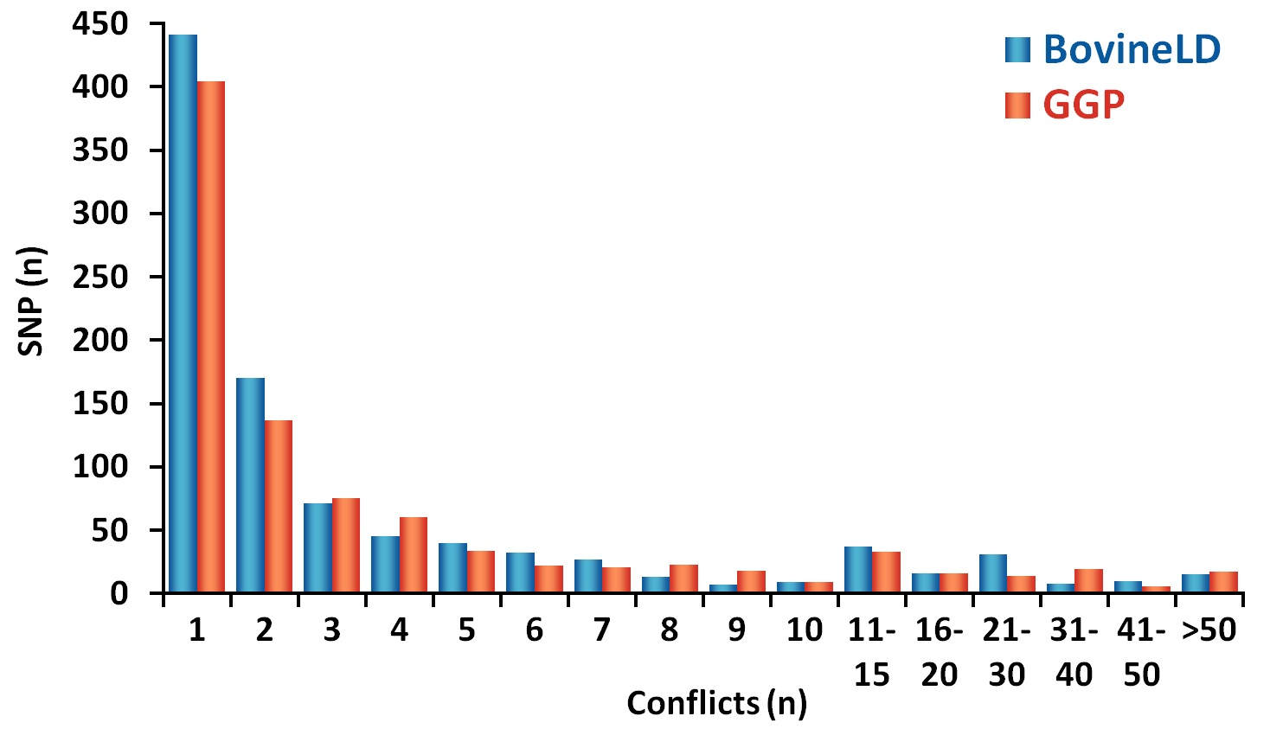
SNP parent-progeny conflicts

Slide 13
Imputation accuracy (%)
Breed | Bovine3K | BovineLD | GGP
Holstein | 95.9 | 98.9 | 99.2
Jersey | 94.6 | 98.3 | 98.9
Brown Swiss | 93.9 | 97.9 | —

Slide 14
Reliability (%) for Holsteins <2 yr old
Animal sex | Genotype | Animals (no.) | Parent Avg | Genomic
Female | Bovine3K | 23,952 | 30.2 | 68.3
 | BovineLD | 32,939 | 26.0 | 70.6
 | GGP | 10,662 | 27.8 | 71.7
 | BovineSNP50 | 13,987 | 30.3 | 74.4
Male | Bovine3K | 1,772 | 33.1 | 68.2
 | BovineLD | 740 | 30.2 | 72.4
 | GGP | 1,736 | 26.0 | 71.6
 | BovineSNP50 | 21,009 | 30.1 | 74.3

Slide 15
GGP-80K
Full 80K SNP added to 6,909 BovineLD SNP
SNP with largest magnitude of effect picked from BovineSNP50 and BovineHD chips
Includes single-gene tests
Expected to be available in September 2012 and to be licensed to other genotyping laboratories
Gives same 0.4 percentage-point increase in reliability as using 300K SNP from BovineHD Chip

Slide 16
Conclusions
Illumina BovineLD BeadChip provides high-quality genotypes
GGP demonstrates the value of the add-on capability of the BovineLD chip
GGP-80K with gene tests and more informative SNP could replace BovineSNP50 BeadChip

